Slide 1

OPEN HEALTH
API
API
API
API
API
The platform to enable democratization of healthcare data
API

Slide 2





We brainstormed a lot of ideas… but we then realized a lot of problems…
Unnecessary load on the care system
Unacceptable work environment for healthcare personnel
Health care data is not available in a standardized way
Long care queues due to lack of healthcare personnel

Slide 3
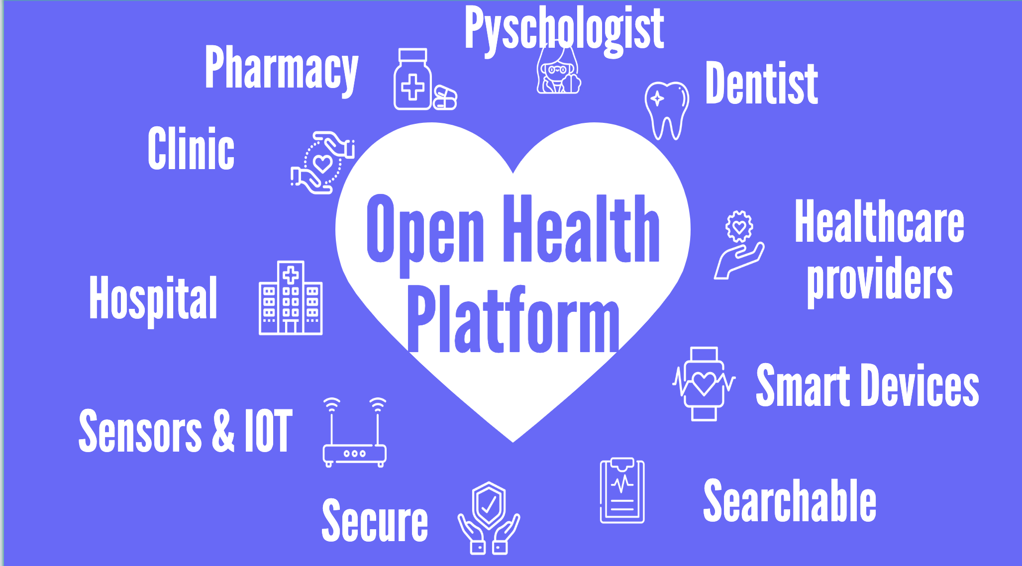

Slide 4
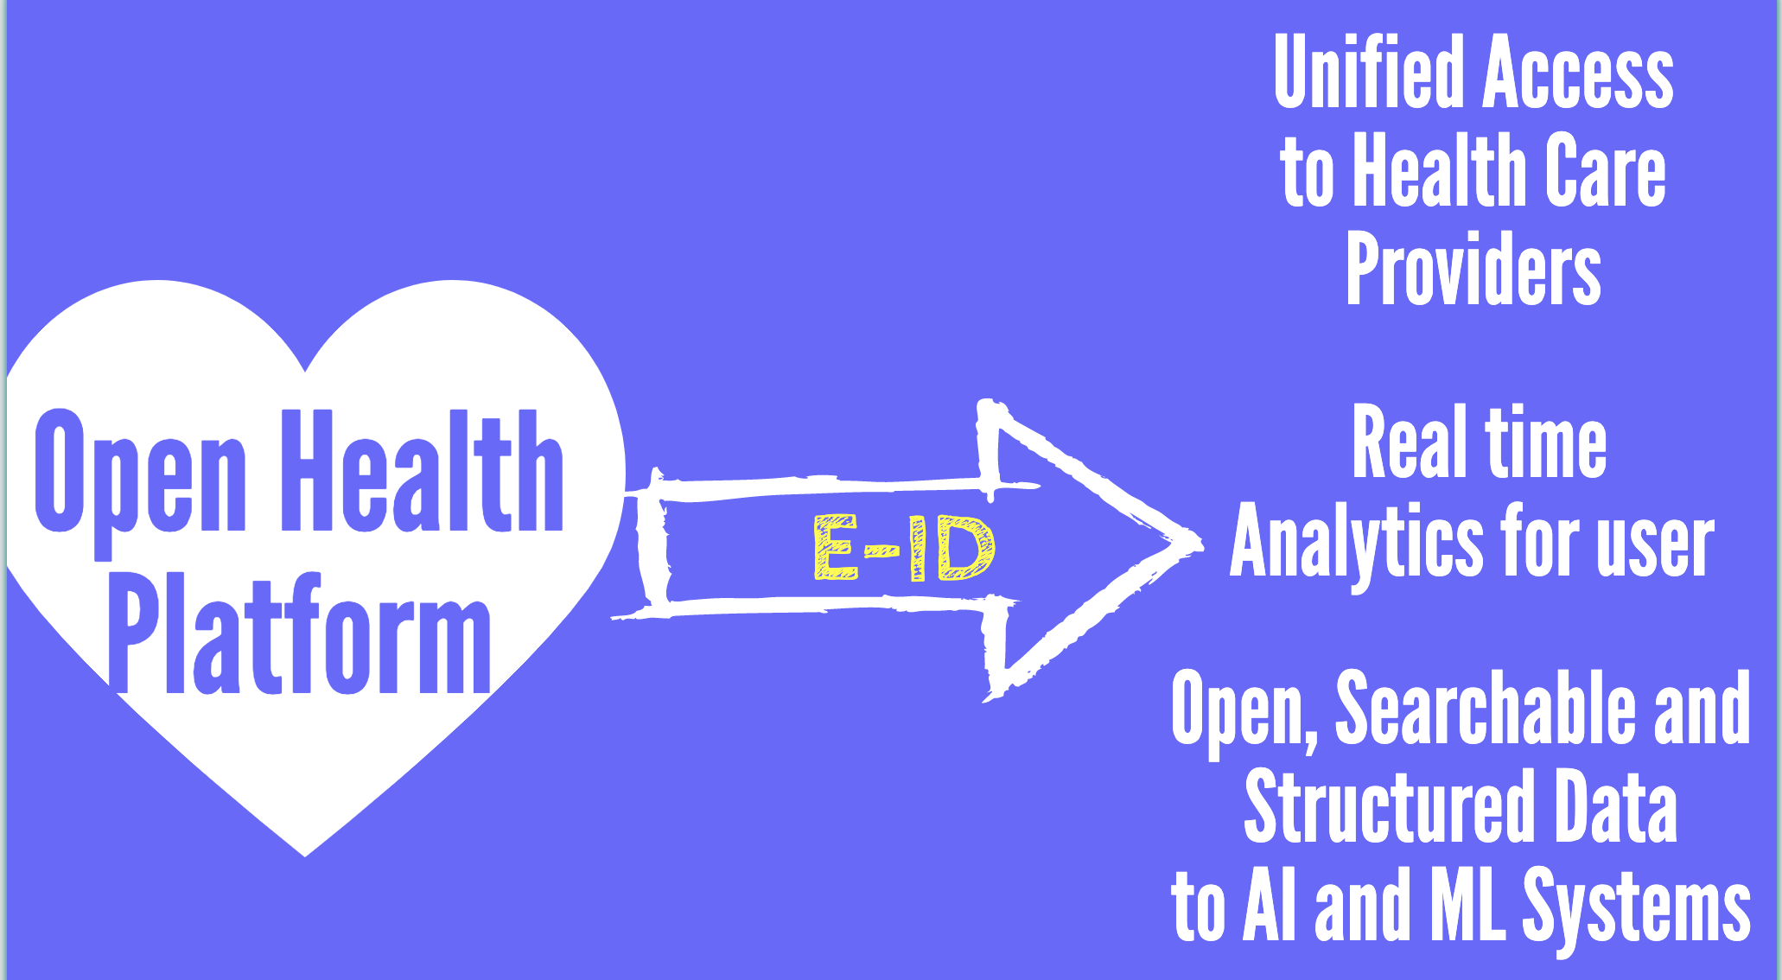

Slide 5
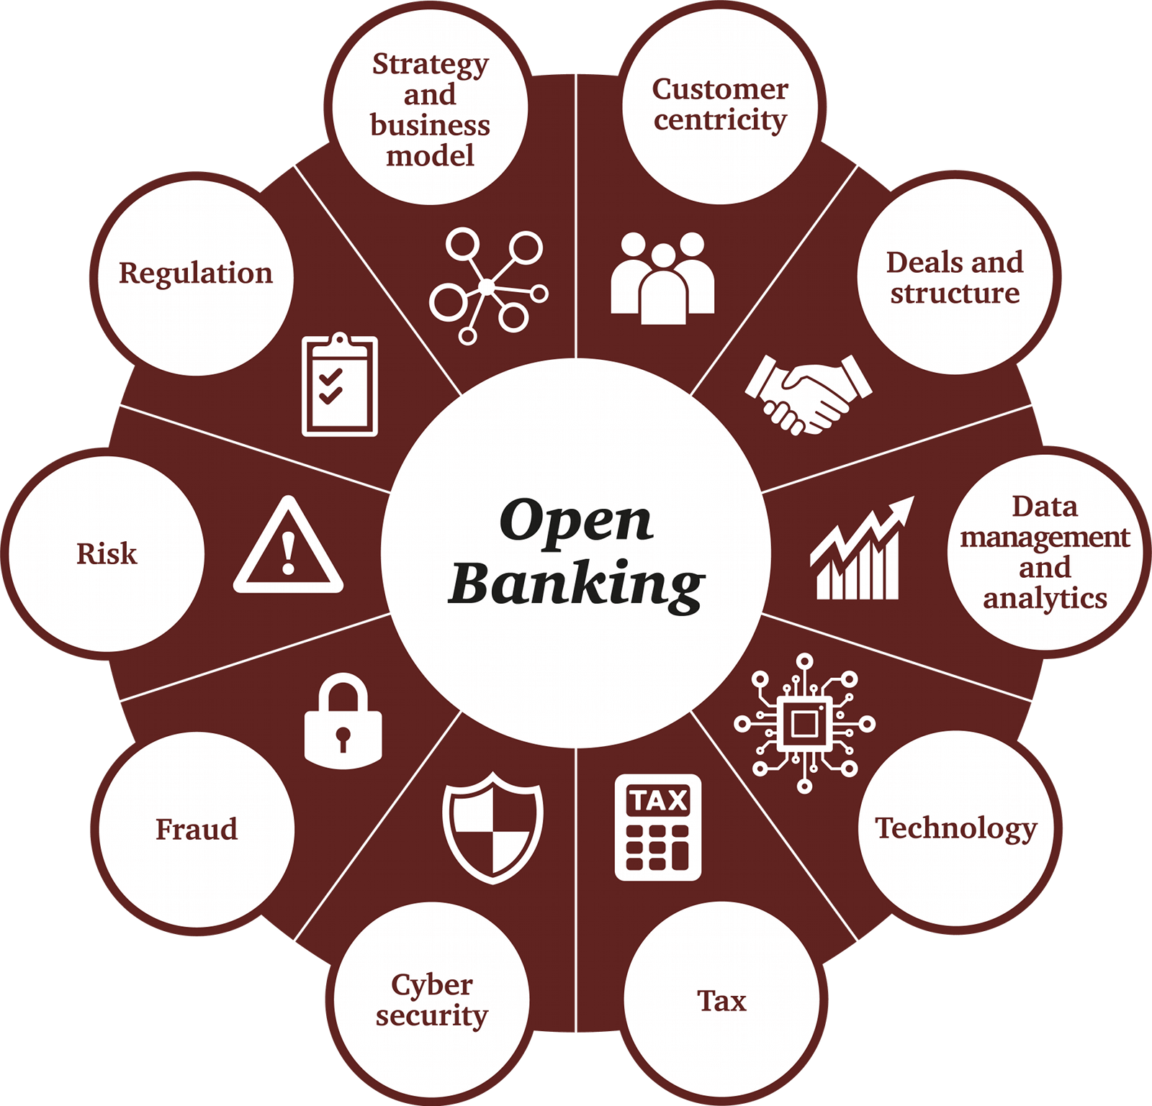

Why is it time to change it now?
It has already been solved in another industry.
Due to customer demand and regulation (PSD2) this has been fixed in the financial industry.
To be able to achieve the UN sustainability goal about…

Slide 6
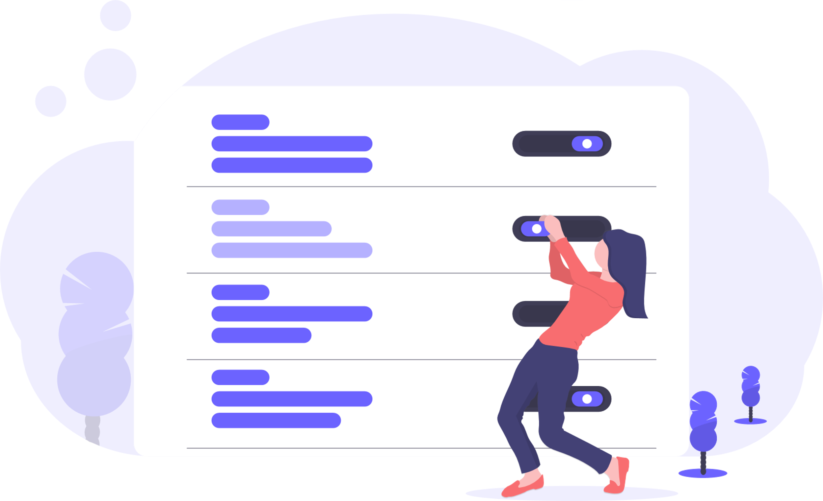


Open Health Platform
Put the health data in control of the individuals.
Make the data available for innovation by third parties with the consent of the individual.
Allow for better preventive & personalized health care.

